Slide 1
Amazon Sales Data Analysis

Slide 2

INTRODUCTION
Amazon (Amazon.com) is the world's largest online retailer and a prominent cloud service provider.
Originally started as an online bookselling company, Amazon has morphed into an internet-based business enterprise that is largely focused on providing e-commerce, cloud computing, digital streaming and artificial intelligence (AI) services.
Following an Amazon-to-buyer sales approach, the company offers a monumental product range and inventory, enabling consumers to buy just about anything, including clothing, beauty supplies, gourmet food, jewelry, books, movies, electronics, pet supplies, furniture, toys, garden supplies and household goods.
Headquartered in Seattle, Amazon has individual websites, software development centers, customer service centers, data centers and fulfillment centers around the world.

Slide 3

PROBLEM STATEMET
Sales management has gained importance to meet increasing competition and the need for improved methods of distribution to reduce cost and to increase profits. Sales management today is the most important function in a commercial and business enterprise.

Slide 4
Insights
&
Dashboard

Slide 5
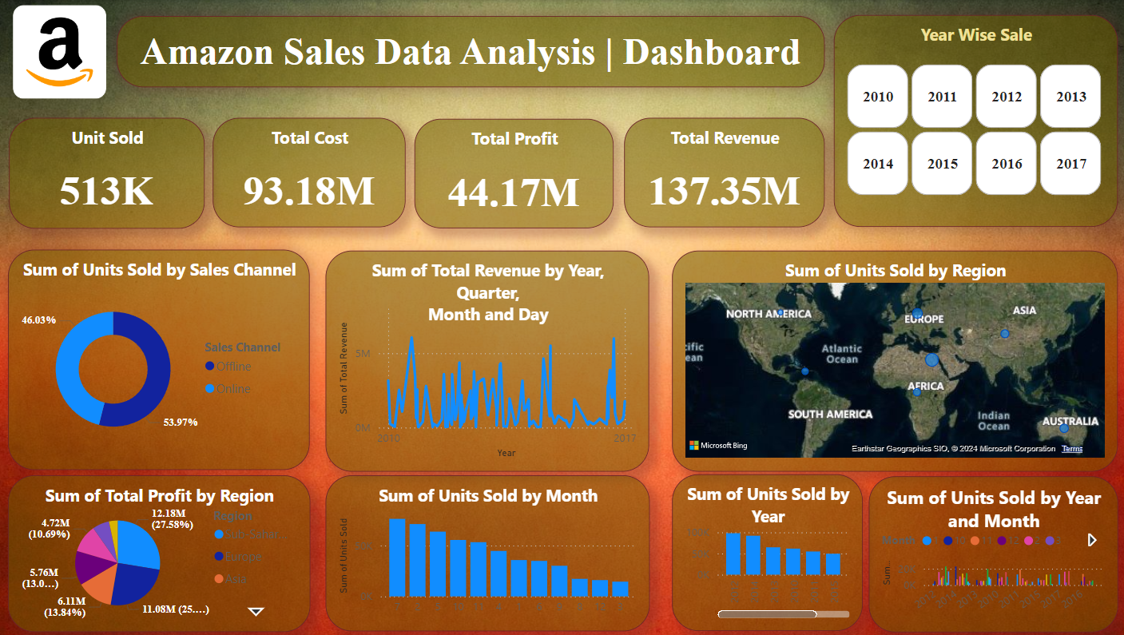
Total Units sold :- 515k
Total Cost :- 93.18M
Total Profit :- 44.17M
Total Revenue :- 137.35M

Slide 6
Sum of Units Sold by Sales Channel
Sum of unit sold by sales channel means the number of product/unit sell by offline mode or online mode.
The Mode of offline sales channel is highlighted In dark blue color and online sales channel is highlighted in light blue color.
The Total number of sales by online mode is 53.97% & by offline mode it is 46.03%. It Varys whenever the year is change or others

Slide 7
Sum of Total Profit by Region
Here is the sum of total profit by the region as shown in the picture.
Different regions are shown in different colours with the total profit of the sales. It is dynamic so it changes on the change of the year or others

Slide 8
SUM OF UNITS SOLD BY YEAR & MONTH

Slide 9
SUM OF TOTAL REVENUE BY YEAR, QUARTER, MONTH & DAY

Slide 10
Conclusion
Effective Sales Management
Distinct performance Management
Regional & Product Specification Contribution
Order Prioritization
Peak period of sales

Slide 12
Employee Attrition Analysis

Slide 13
PROBLEM STATEMET
XYZ company which was established a few years back is facing around a 15% attrition rate for a couple of years. And it's majorly affecting the company in many aspects. In order to understand why employees are leaving the company and reduce the attrition rate XYZ company has approached an HR analytics consultancy for analyzing the data they have. You are playing the HR analyst role in this project and building a dashboard which can help the organization in making data-driven decisions

Slide 14
Insights
&
Dashboard

Slide 15
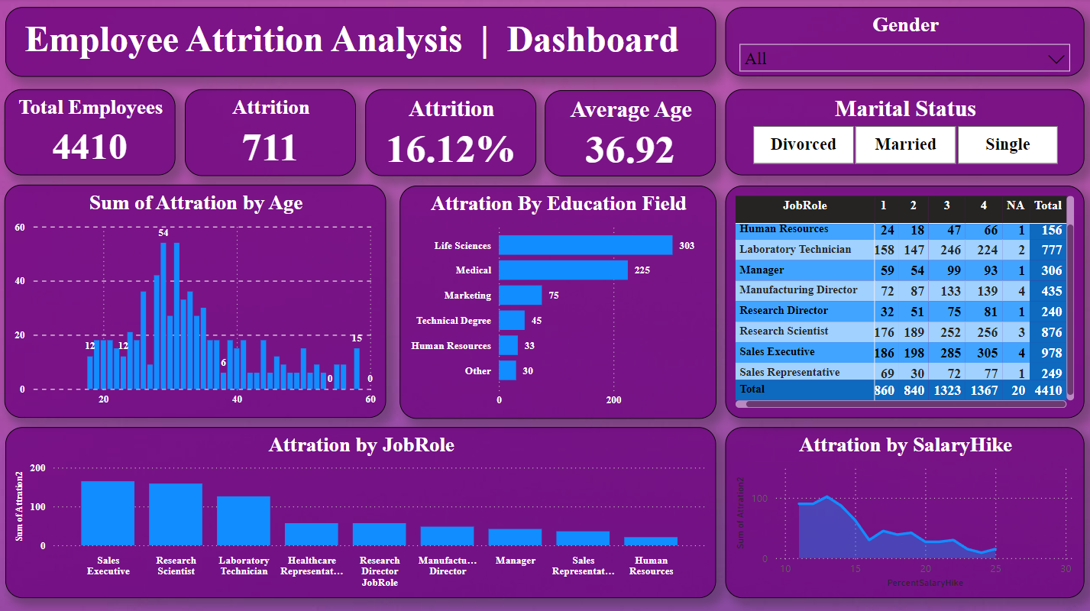
Total Employees :- 4410
Employee Attrition :- 711
Attrition In % :- 16.12
Average Age :- 36.92

Slide 16
Sum of Attrition by Age

Slide 17
Attrition by education Field

Slide 18
Attrition by JobRole

Slide 19
Attrition by SalaryHike

Slide 20
Crop Production Analysis in India

Slide 21
Introduction
Production
India is one of the world's top producers of many crops, including wheat, rice, pulses, cotton, peanuts, fruits, and vegetables. In 2022-23, India's estimated production of major crops was 3296.87 lakh tones of foodgrains, 1357.55 lakh tonnes of rice, and 1105.54 lakh tones of wheat.
Arable land
India has the second largest arable land area in the world, after the United States.
Irrigation
India has the largest gross irrigated crop area in the world.
Crop types
India's main crops include Kharif crops, which are sown during the rainy season, and Rabi crops, which are sown during the winter.

Slide 22
Production trends
India's food grain production has been increasing every year. In 1948–49, food grain production was 50 million tons, but by 1996–97, it had increased to 198 million tons.
Production methods
The increase in food production has been attributed to the use of high-yielding seed varieties, advanced irrigation facilities, and agricultural chemicals. Pesticides have also played an important role in decreasing losses from unwanted plants, diseases, and insect pests.

Slide 23
Problem Statement
The Agriculture business domain, as a vital part of the overall supply chain, is expected to highly evolve in the upcoming years via the developments, which are taking place on the side of the Future Internet. This paper presents a novel Business-to-Business collaboration platform from the agri-food sector perspective, which aims to facilitate the collaboration of numerous stakeholders belonging to associated business domains, in an effective and flexible manner.

Slide 24
Insights
&
Dashboard

Slide 25
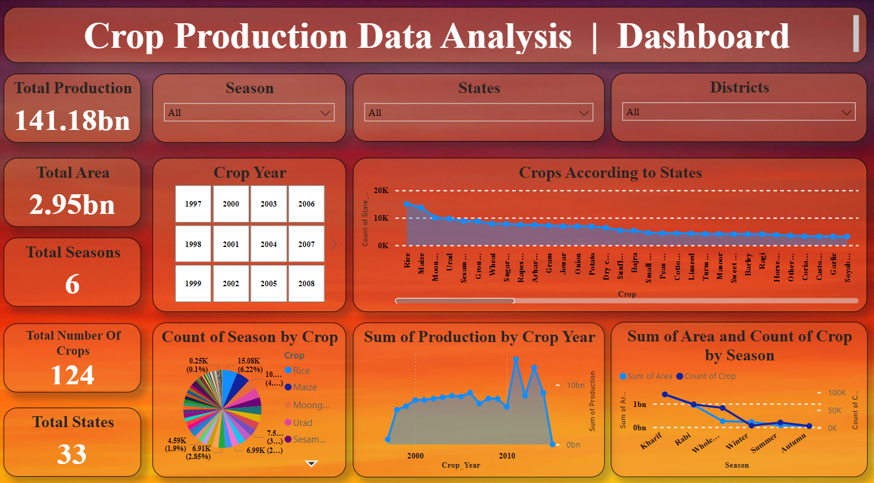
Here,
Total Production :- 141.18bn
Total Area :- 2.95bn
Total Season :- 6
Total Numbers of Crops :- 124
Total States :- 33

Slide 26
Count of Season By Crops

Slide 27
Showing of Crops According to the states

Slide 28
Sum pf Production by Crop Year

Slide 29
Total Sum of Area & Count of Crop easonby

Slide 30
Thank You…!

